Slide 1
RATION SHOP AUTOMATION SYSTEM
TEAM MEMBERS:
ASHWIN VELMURUGAN(13BCS018)
S.ABUBACKER ASHIQ(13BCS002)
S.AJITH PRUTHVI(13BCS003)
PROJECT GUIDE: Mr.G. KANGARAJ, M.E.,

Slide 2
OVERVIEW
PROBLEM STATEMENT
ABSTRACT
LITERATURE SURVEY
REQUIREMENTS
ARCHITECTURE DIAGRAM
ARCHITECTURAL DESIGN
MODULES
SOURCE CODE
REFERENCES

Slide 3
PROBLEM STATEMENT
In the conventional ration system there are lot of chances for illegal usage of products and also possibility for inaccurate quantity of material.
The system must be able to automate the entire process of billing and distribution of ration shop commodities.

Slide 4
ABSTRACT
Ration shop automation is an arduino based project which automates the conventional ration system
RFID tags are used as a smart card for identification and a display is provided to select the items needed
If the required amount is available in stock then the commodities are provided to the customers

Slide 5
LITERATURE SURVEY
“Automation in Rationing System using ARM7”
By:
A.N Madur, Sham Nayse
This system is based on the radio frequency identification of customer.
The updated account information is sent to the customer’s mobile using GSM module.

Slide 6
CONTD…
“Automatic Rationing for Public Distribution System (PDS) using RFID and GSM Module to Prevent Irregularities”
By:
Rajesh C. Pingle, P. B. Borole.
conventional ration card is replaced by smartcard.
Database is connected to the system to maintain the transactions.
Transparency in public distribution system and
there will be a direct communication between people and Government through this.

Slide 7
CONTD…
”Automatic Ration Material Distributions Based on GSM and RFID Technology”
By:
S.Valarmathy, R.Ramani
This System uses a RFID Tag to authenticate the card holders.
In this system we use a PLC controller in order to control the weight count of the subsidies.
Updation is made based on each transaction.

Slide 8
CONTD…
“Cloud-Based Ration Card System using RFID and GSM Technology”
By:
K.Balakarthik
OTP for authenticating users.
check purchase details in a dedicated website.
cloud storage is used.

Slide 9
REQUIREMENTS
RFID Tag and Reader
Arduino board
Model part which includes the proximity sensor, funnel, DC motor and crank mechanism

Slide 10
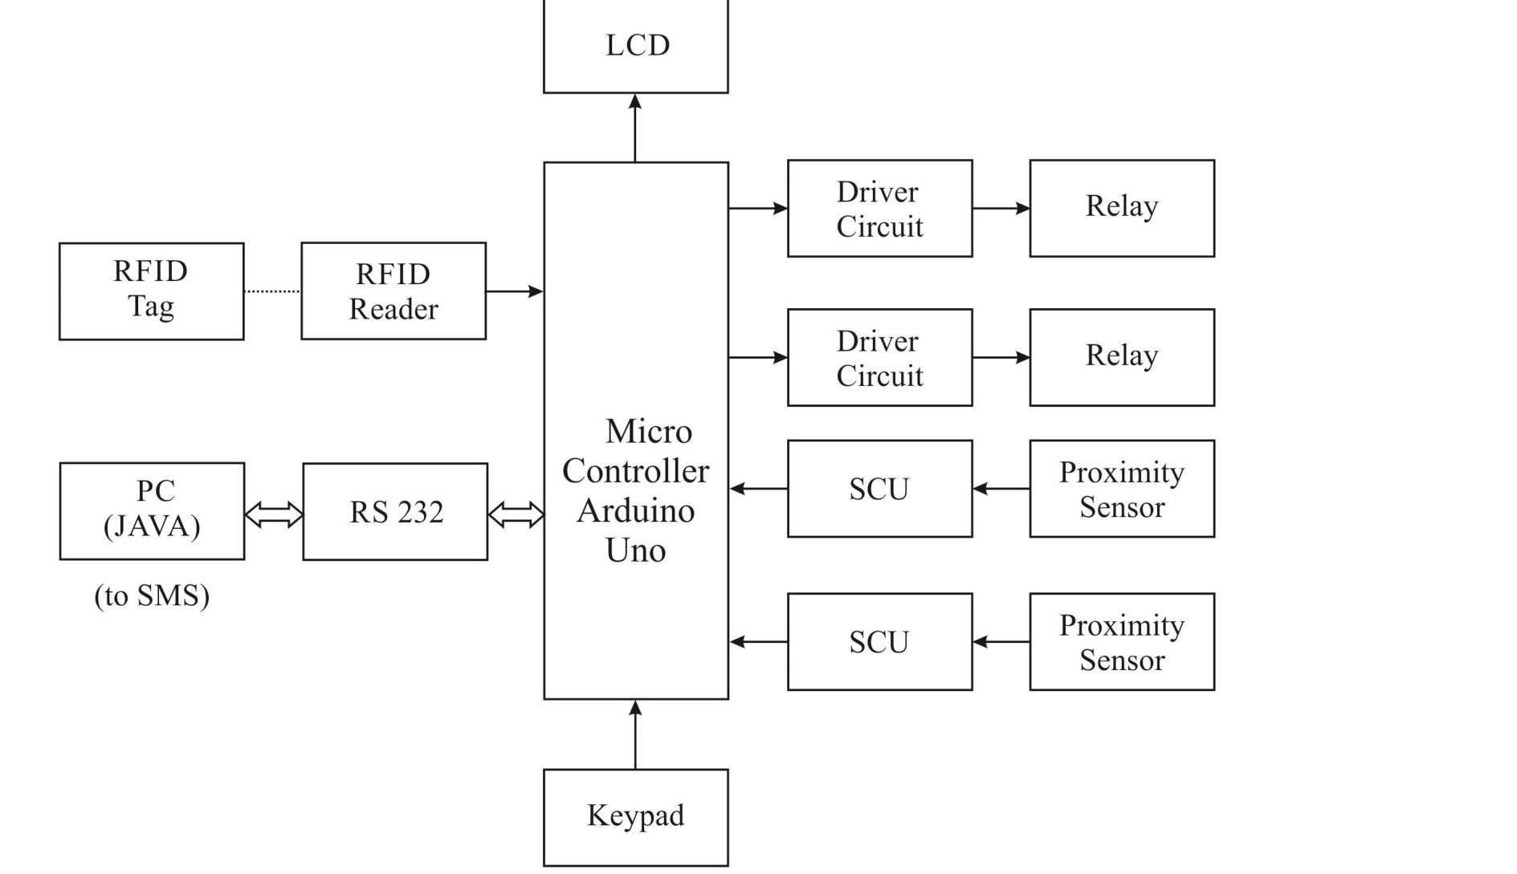
ARCHITECTURE DIAGRAM

Slide 11
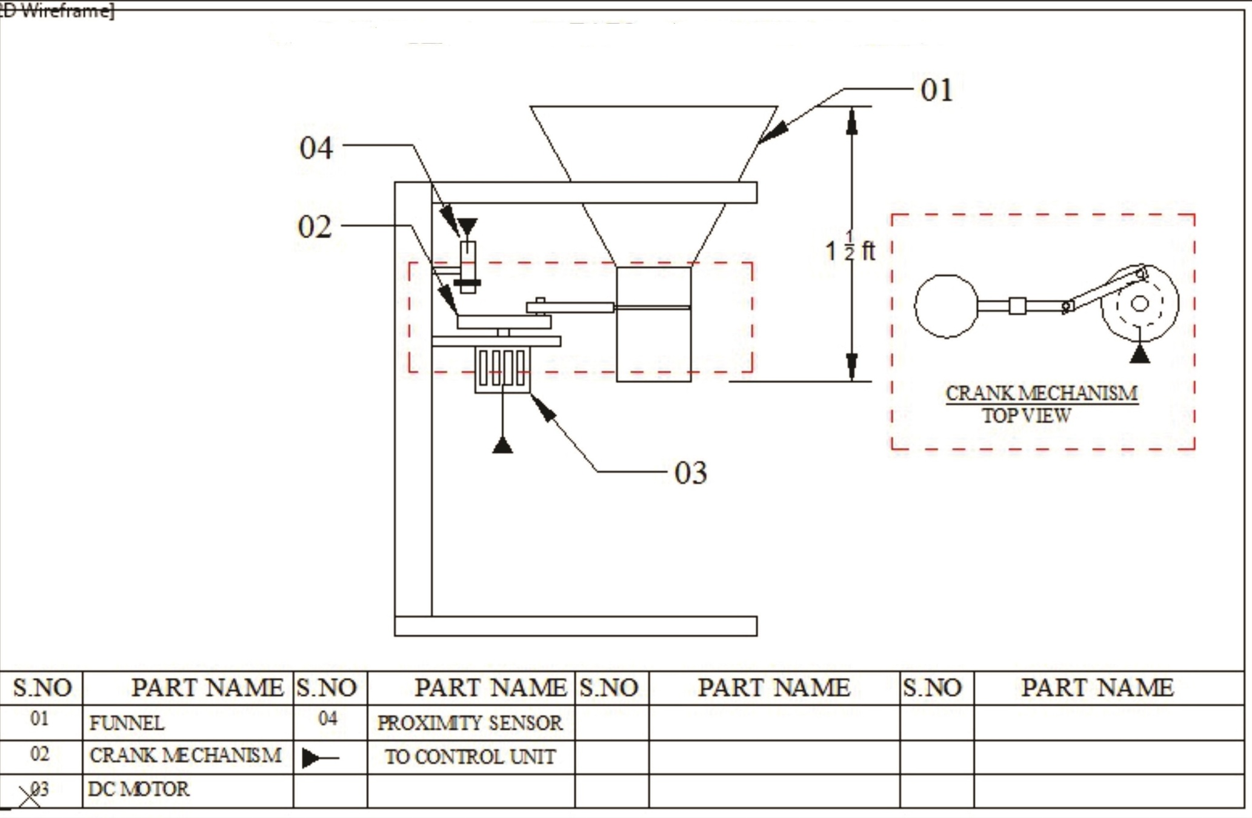

Slide 12
ARCHITECTURAL DESIGN
RFID tag is scanned by the RFID reader and if authorised user then allow the customer to enter the required commodities
If the required commodities are available then it is distributed to the customer through valve, and an SMS is sent to the registered phone number
The customer can check the SMS for their transactions and purchased commodities.

Slide 13
MODULES
The modules are :
RFID module
Commodities distribution module
SMS module

Slide 14
RFID MODULE
Each family is provided with a smart card which is a replacement of conventional ration card
The smart card is used as an authentication for purchasing the commodities from ration shop
RFID reader scan the tag and check the database for the correct user
Authenticated card holder is allowed to place order

Slide 15
COMMODITIES DISTRIBUTION MODULE
The arduino board is the core of this module where the devices such as solenoid and valve is attached and also the gateway for SMS is also connected
An SMS is sent to the corresponding phone number after purchase
The required amount is given using a system and it is provided through the valve

Slide 16
SMS
An SMS would be sent to the corresponding valid card holder after their transactions.
The SMS contains information regarding the purchases made by the customer also indicating the availability of products in quantitative terms.

Slide 17
SOURCE CODE
#include <LiquidCrystal.h>
#include <string.h>
char card1[13]="08009565C3";
char card2[13]="080095743D";
char card3[13]="0800954E1E";
LiquidCrystal lcd(12,11,10,9,8,7);
const int Set=3;
const int mov=4;
char rec[13],index;
void mydecimal(unsigned int a1,char pos,char j)
{
a1=a1%10000;
lcd.setCursor(0+pos,j);
lcd.write(a1%10000/1000+0x30);
lcd.setCursor(1+pos,j);
lcd.write(a1%1000/100+0x30);
lcd.setCursor(2+pos,j); l
cd.write(a1%100/10+0x30);
lcd.setCursor(3+pos,j);
lcd.write(a1%10/1+0x30);
}

Slide 18
void Lcd8_Decimal3(unsigned char val)
{
unsigned int Lcd_h,Lcd_hr,Lcd_t,Lcd_o;
Lcd_h=val/100;
Lcd_hr=val%100;
Lcd_t=Lcd_hr/10;
Lcd_o=Lcd_hr%10;
Serial.print(Lcd_h);
Serial.print(Lcd_t);
Serial.print(Lcd_o);
}
void setup()
{
pinMode(Set,INPUT_PULLUP);
pinMode(mov,INPUT_PULLUP);
lcd.begin(16,2);
lcd.setCursor(0,0);
lcd.print(" SHOW YOUR CARD ");
lcd.setCursor(0,1);
lcd.print(" ");
Serial.begin(9600);
Serial.println("WORKING FINE");
}

Slide 19
void loop()
{
if(index>=10)
{
int j;
for(j=0;j<10;j++)
{
lcd.setCursor(0+j,1);
lcd.write(rec[j]);
}
if((strncmp(rec,card1,10))==0)
{
lcd.setCursor(11,1);
lcd.print("KAMAL");
}

Slide 20
else if((strncmp(rec,card2,10))==0)
{
lcd.setCursor(11,1);
lcd.print("GURU");
}
else if((strncmp(rec,card3,10))==0)
{
lcd.setCursor(11,1);
lcd.print("RAJ");
}
index=0;
}
}

Slide 21
void serialEvent()
{
if(Serial.available())
{
rec[index++]=(char)Serial.read();
}
}
Wire.beginTransmission(0x50);
Wire.write(0);
Wire.write(credit);
Wire.write(credit>>8);
Wire.endTransmission();
delay(1500);

Slide 22
REFERENCES
[1]. A.N.Madur,Sham Nayse -Automation in Rationing System using Arm. International Research Journal of Engineering and Technology Volume 02 Issue 03 June-2015.
[2]. Rajesh C. Pingle, P. B. Borole-Automatic Rationing for Public Distribution System (PDS) using RFID and GSM Module to Prevent Irregularities. International Journal of Technical Research and Applications Volume 3, Issue 6 December, 2015.
[3].S.Valarmathy,R.Ramani-Automatic Ration Material Distributions Based on GSM and RFID Technology.International Journal of Technical Research and Applications Volume1,Issue 8, November 2013.
[4].S.Sukhumar, K.Gopinathan, S.Kalpanadevi, P.Naveenkumar, N.Suthanthira Vanitha -International Journal Of Innovative Research In Electrical, Electronics, Instrumentation and Control Engineering Vol. 1, Issue 8, November 2013

Slide 23
THANK YOU

